Slide 1
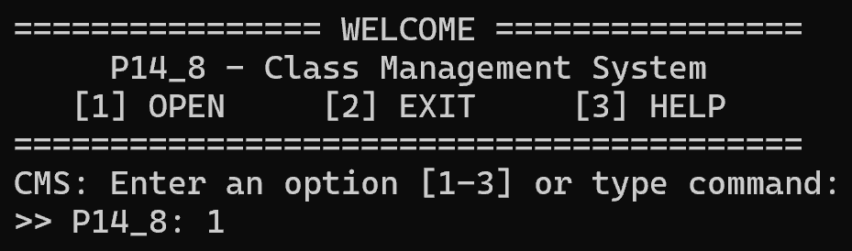
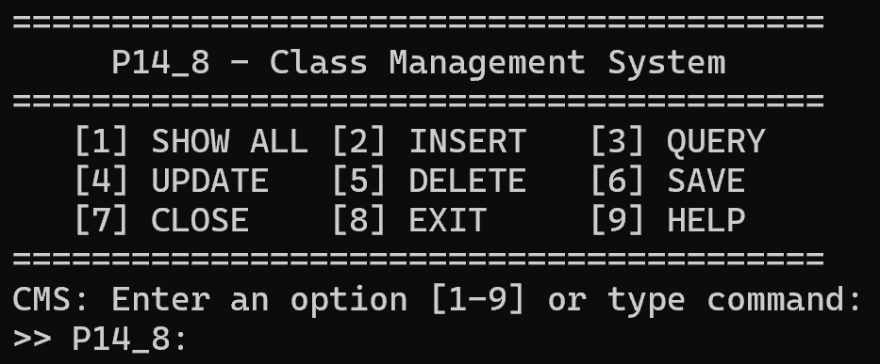
P14-8 CLASS MANAGEMENT SYSTEM (CMS)
James Hong (2402817)
Choong Wan Qin (2402311)
Yek Yi Wei (2402288)
Brian Liew (2402342)
Wayne Lim (2402220)
Notes:
Good evening professors…intro.
Presenting on our CMS, a command line program developed in C.
As you/everyone is already familiar with its purpose, we will skip its purpose and go straight to the technical aspects of the program.

Slide 2
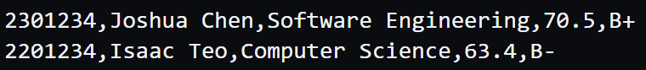
DATABASE DESIGN (CSV Format)
Student ID | Name | Programme | Marks | Grade
2301234 | Joshua Chen | Software Engineer | 70.5 | B+
2201234 | Isaac Teo | Computer Science | 63.4 | B-
Notes:
Before starting the project, we had a few things to consider for data management.
First was to decide how to format our data in the text file.
Eventually landed on Comma-Separated Value format (CSV), as it was a widely recognized format, simple and compatible with tools like Excel and other programming libraries.

Slide 3
DATA STRUCTURE (LINKED LIST)
Linked List could dynamically allocate memory
Efficient insert and delete operations
DATABASE
LINKED LIST
Notes:
We also had to consider what data structure to use when running loading the data on program runtime.
We stuck with linked list as it was able dynamically allocate memory according to the size of the database file.
It also had the added advantage of more efficient insert and delete operations compared to arrays.

Slide 4
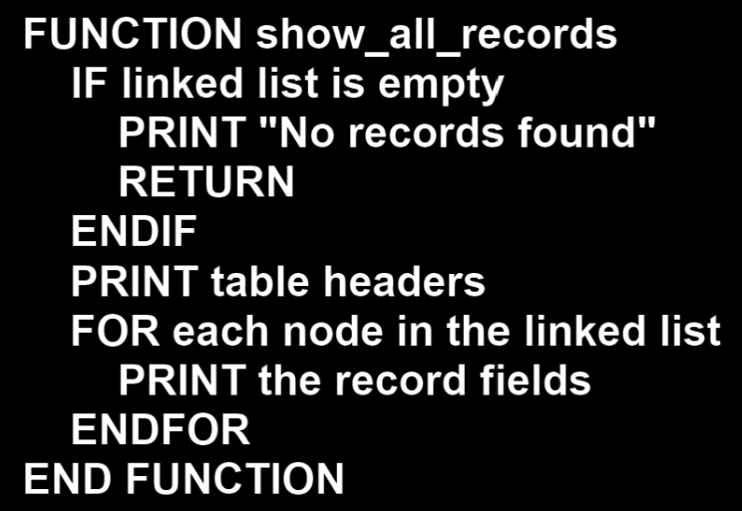
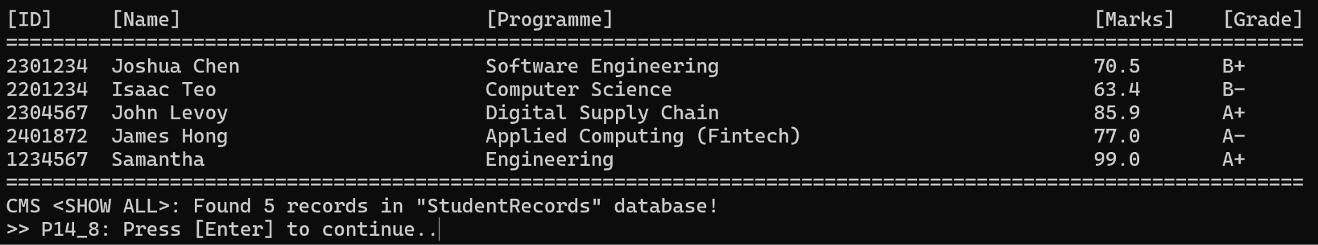
MAIN FEATURE (SHOW ALL)
Show all student records in a well-structured, tabular format.

Slide 5
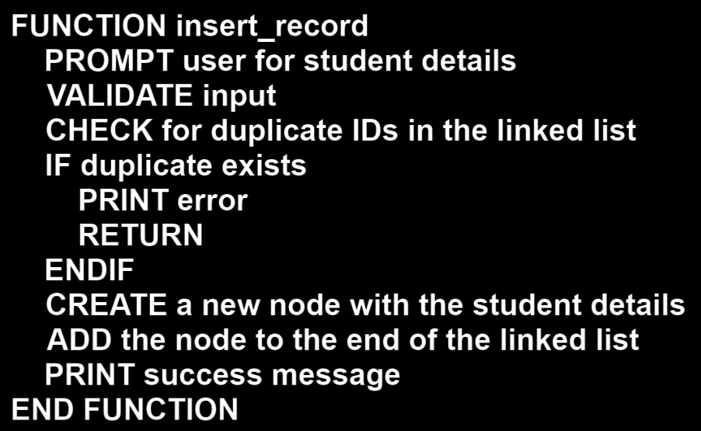
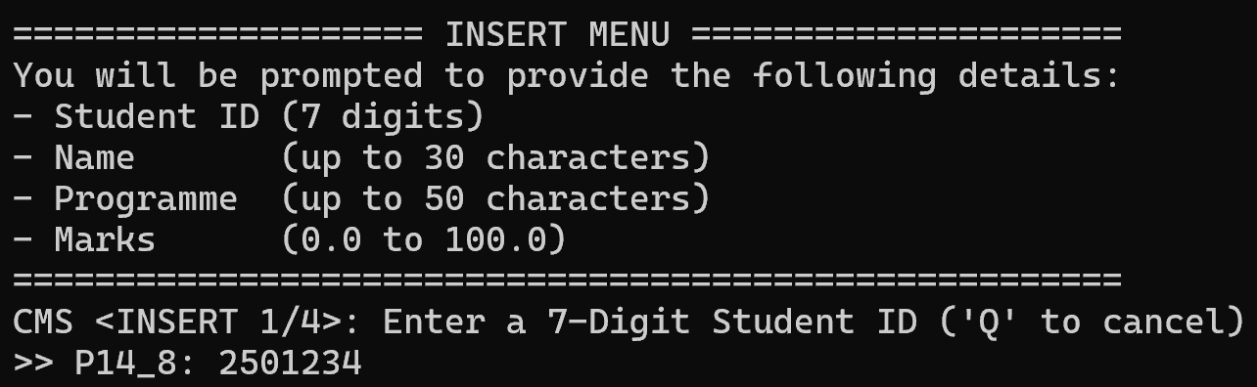
MAIN FEATURE (INSERT)
Allows addition of new student records by prompting for inputs.

Slide 6
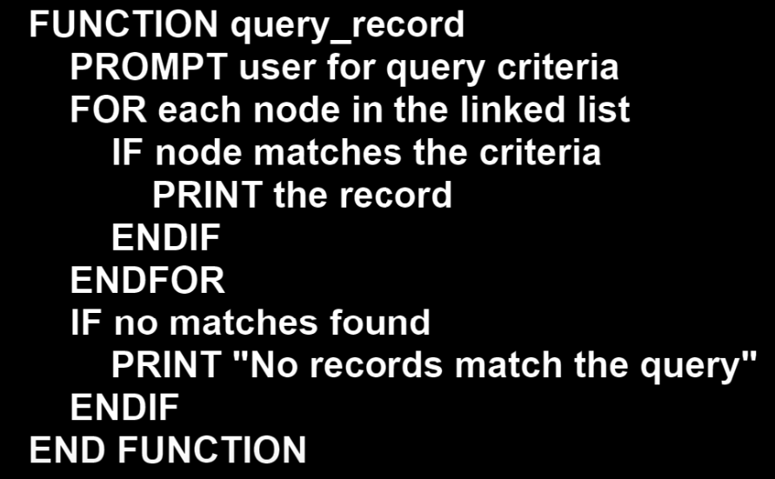
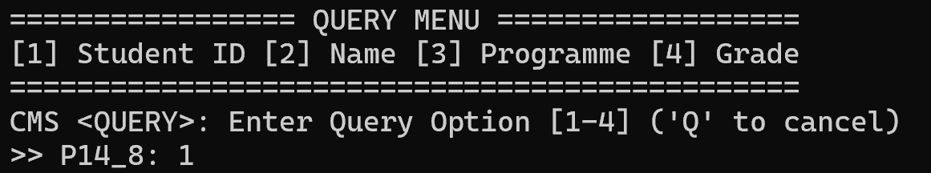
MAIN FEATURE (QUERY)
Show all student records in a well-structured, tabular format.

Slide 7
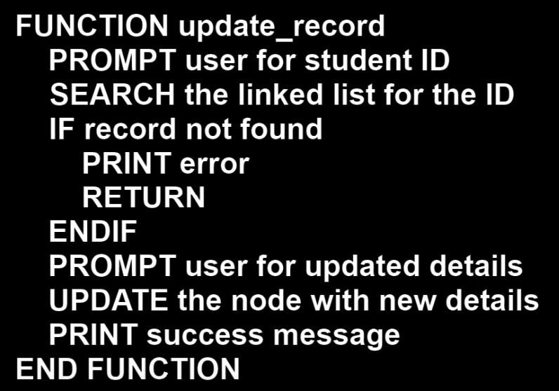
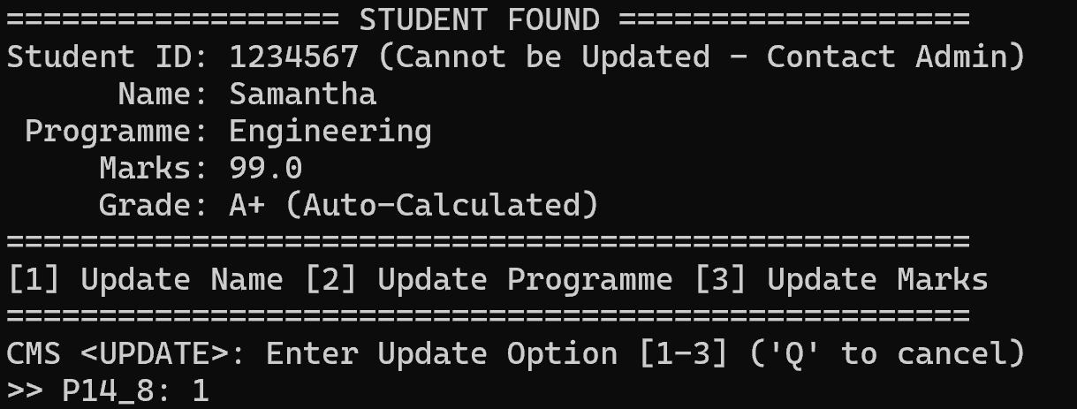
MAIN FEATURE (UPDATE)
Allows modifications to existing records, including updates to name, programme, or marks.

Slide 8
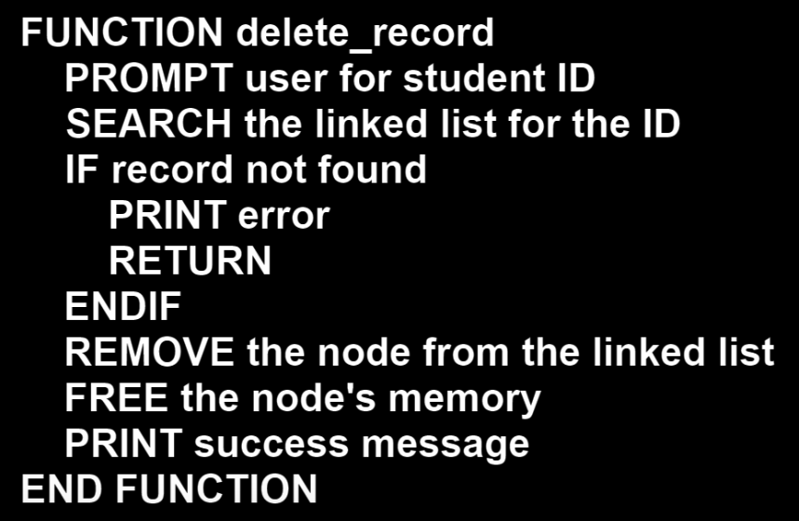
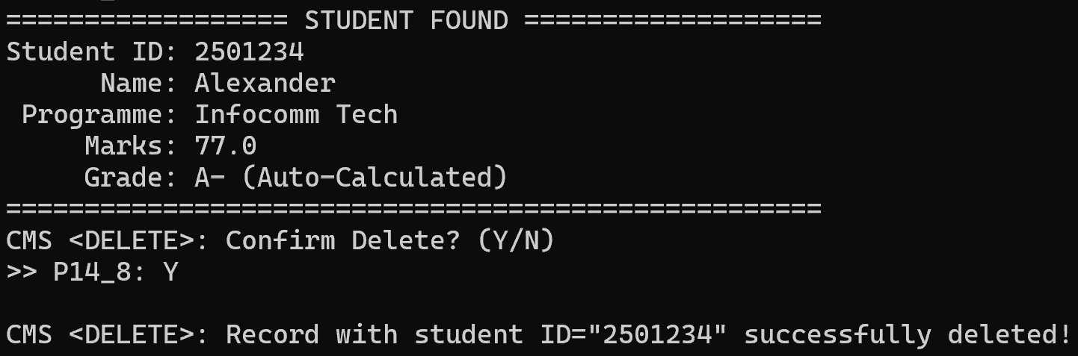
MAIN FEATURE (DELETE)
Delete existing student records using student ID.

Slide 9
LIVE DEMO
LIVE DEMO
Notes:
We also had to consider what data structure to use when running loading the data on program runtime.
We stuck with linked list as it was able dynamically allocate memory according to the size of the database file.
It also had the added advantage of more efficient insert and delete operations compared to arrays.

